Slide 1
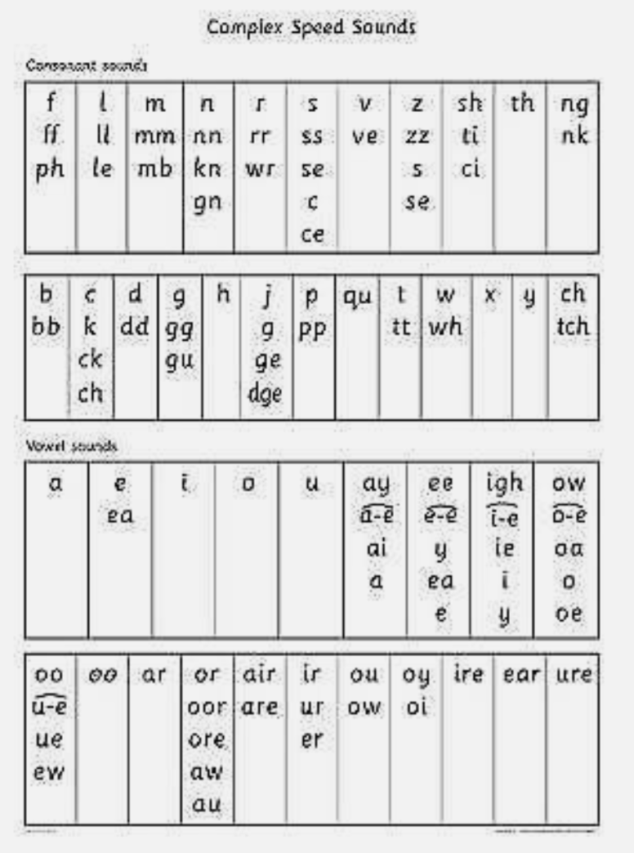
Welcome!

Slide 2
What is phonics?
The method of teaching children how to read and write by correlating sounds (phonemes) with letters (graphemes).
How the word cat is broken down into sounds: /c/ /a/ /t/.

Slide 3
In year 1…
Children move beyond simple letter sounds into more complex sound patterns.
Children learn to recognise digraphs (two letters making one sound) and trigraphs (three letters making one sound).
Blending sounds together helps with reading and segmenting helps with spelling.

Slide 4
Let’s go through the sounds…
https://www.youtube.com/watch?v=rn_ZB2tE8l4
https://www.youtube.com/watch?v=wkf2WSpMrcg
Notes:
Go through flashcards

Slide 5
How do we teach phonics?
Notes:
Short demonstration

Slide 6
Phonics screener
At the end of year 1 your child will be tested on their proficiency to read real and alien words.

Slide 7
How can you help at home?
Reading together- children who have more practice at reading can blend and segment better.
Phonics games.
Spelling practice.

Slide 8
Any questions?

