Slide 1
Year 6
Statutory Assessments
Parent’s Evening

Slide 2
Aims and Objectives
Dates and assessment timetable
What subjects are tested
What SATs are and are not
Outline of how we will prepare the children
How parents can support
Test week practical information
Questions?
SATs past papers and text books

Slide 3
Dates and assessment timetable
The SATs for Key Stage 2 will take place from May 11 to May 14, 2026
Monday | Tuesday | Wednesday | Thursday
Spelling, Punctuation and Grammar paper 1 45 minutes | English Reading 1 hour | Maths paper 1 arithmetic 30 minutes | Maths paper 2 Reasoning 40 minutes
Spelling, Punctuation and Grammar Paper 2 15 minutes |  | Maths – paper 2 Reasoning 40 minutes

Slide 4

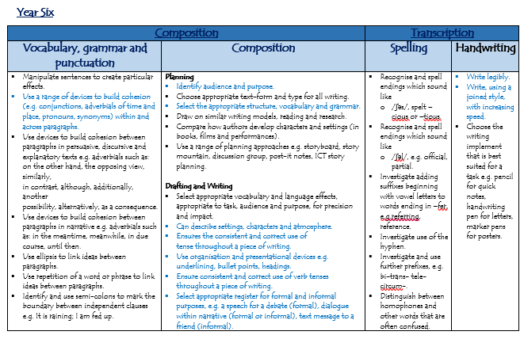

Slide 5
What SATs are and are not
SATs are:
To assess progress nationally from Reception to end of KS2 and then be used as benchmark for GCSE targets.
Marked externally and reported to school in July.
A tool for secondary schools to group children appropriate to their attainment.
SATs are not /do not:
To rank children.
Measure a child’s creativity, kindness and wider skills.
Measure all of a child’s abilities and secondary schools use a range of information, such as their teacher’s assessments not just their SATs.

Slide 6
How we will prepare the children
Three mock tests:
  Autumn 2
  Spring 1
  Spring 2
Question practice during lesson time
Homework targeted on gaps and test type content
After school SATs club – from Spring 1

Slide 7
How parents can support
Go through past papers with your children
Support them with their homework
Ask them comprehension questions, after they have read.
Allow them time to practise areas identified in gap analysis on BBC Bitesize or Purple Mash.

Slide 8
Test week practical information
Sleep is very important, try to encourage early nights.
Ensure children are in school and on time.
Children can come to the office for 8.30 for a cereal bar or fruit and to be calm before the day starts.
Ensure children have a water bottle and their lunch, PE kit etc. otherwise they will worry.
They will have regular break and lunch times.

Slide 9

Questions?

Slide 10
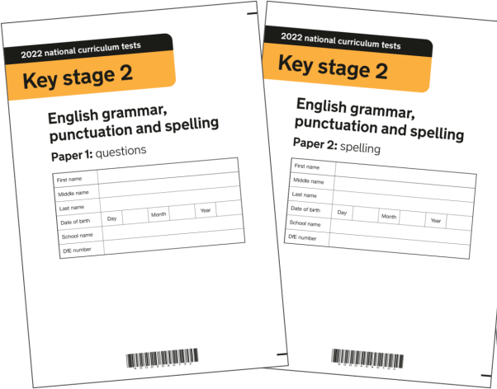
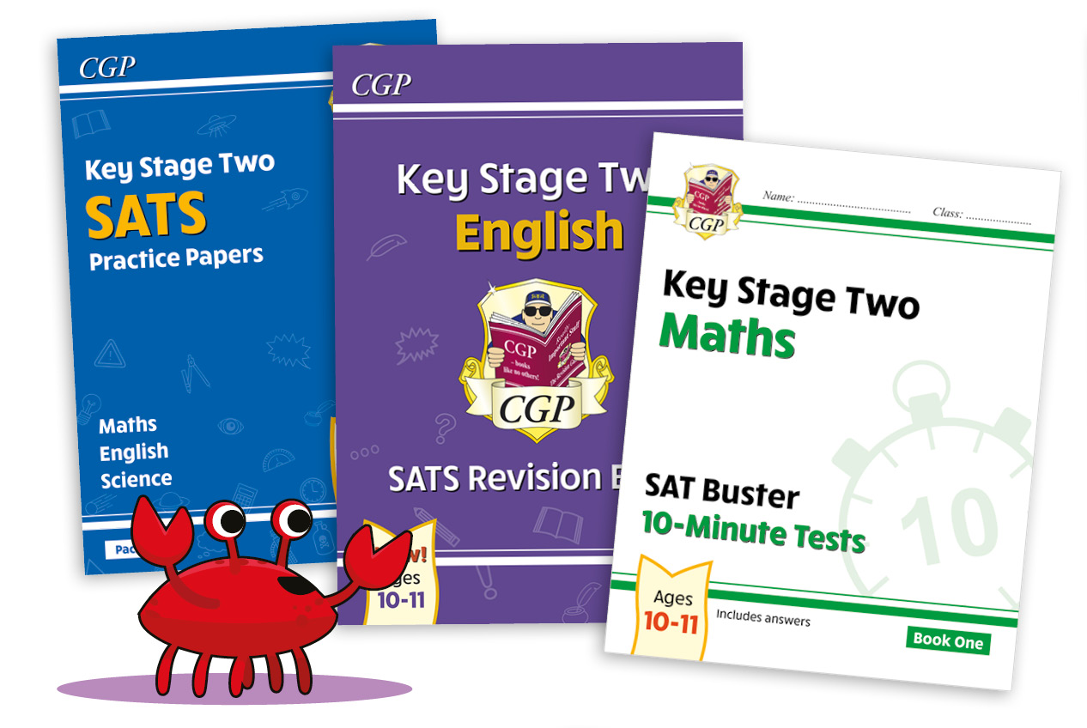
Past papers
&
Text books

