Slide 1
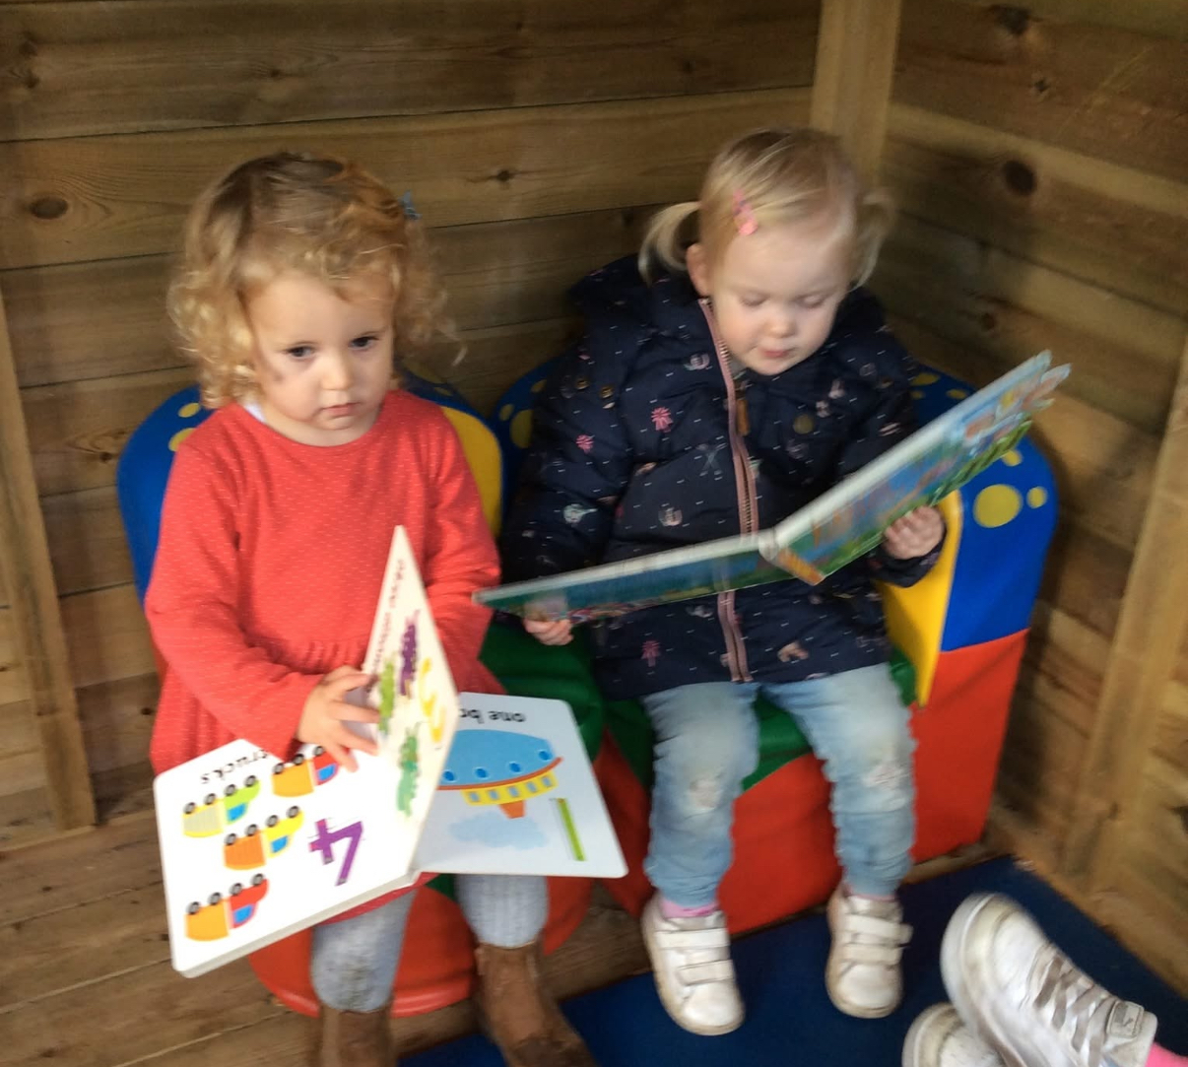
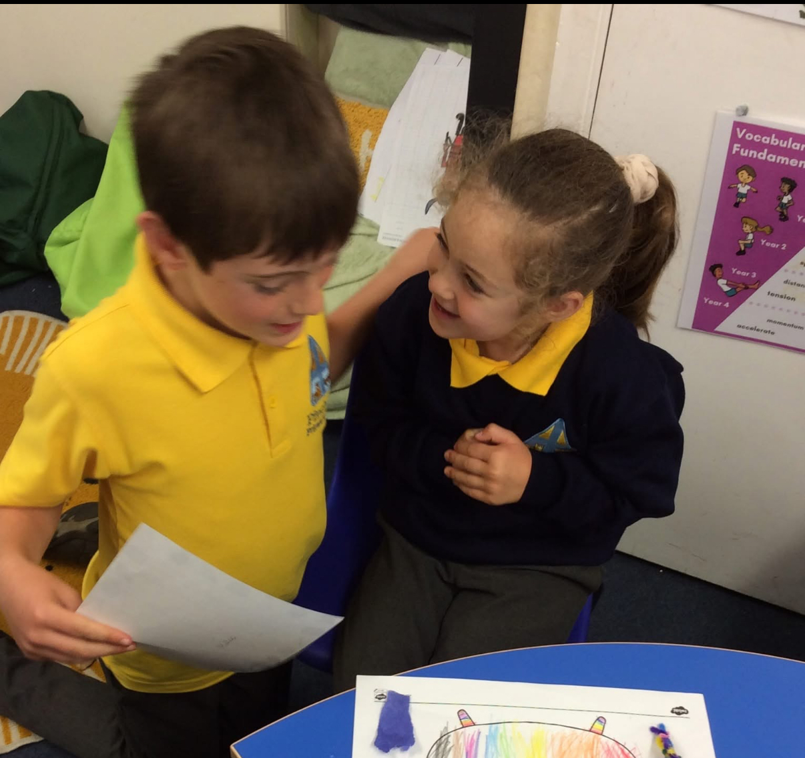
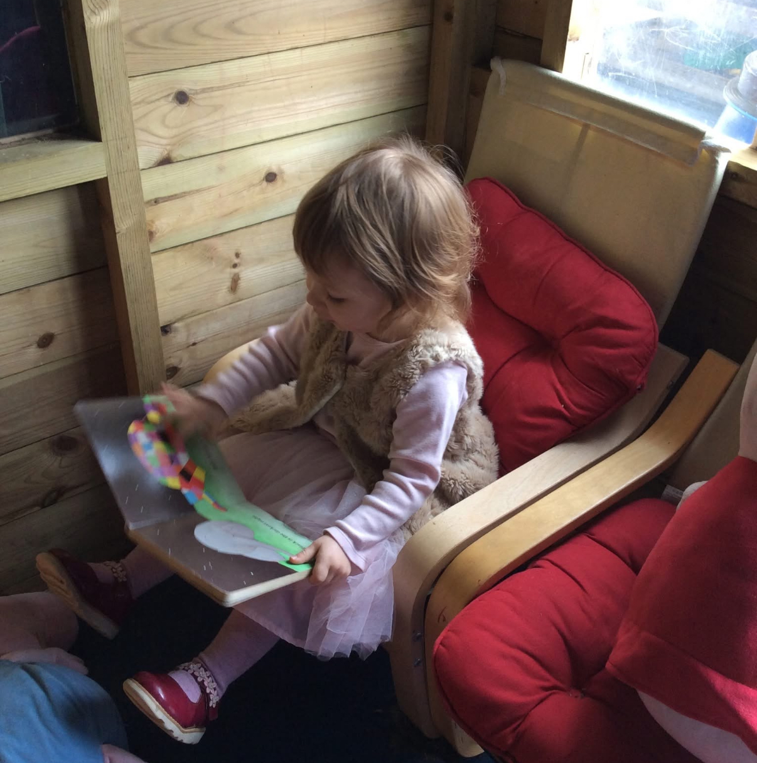
Reading Parent Workshop
January 2026- EYFS

Slide 2
What we’re going to cover…
What is phonics?
Our chosen phonics scheme.
How phonics is taught.
Progression throughout the school.
The importance of pronouncing pure sounds.
Supporting your child with reading at home.
Notes:
Laura

Slide 3
What is phonics?
A method of teaching beginners to read and pronounce words by learning to associate letters or letter groups with the sounds they represent.
There are 44 main sounds in the English Language. Each sound is represented by a grapheme (the written representation of a sound).
Notes:
Lucy

Slide 4
What is phonics?
Phoneme: the smallest single identifiable sound in a word.
For example, in the word 'cat' there are three phonemes c/a/t.
Grapheme: the written representation of a sound.
Digraph: two letters making one sound. For example, /sh/ in the
word 'shop'.
Trigraph: three letters making one sound. For example, /igh/ in the
word 'night'.
Split digraph: two vowel letters split but are split by one or more
consonants. For example, /a-e/ in the word 'cake'.
Notes:
Lucy

Slide 5

Children will experience the joy of books and language whilst rapidly acquiring the skills they need to become fluent independent readers and writers.
Notes:
Our chosen phonics scheme is ELS, essential letters and sounds.
Laura

Slide 6
“We aim for all children to read well, quickly.”
Notes:
Lucy

Slide 7
How do we teach phonics?
We use a simple, consistent approach to teaching phonics.
We have mnemonics and rhymes to support learning and recall
We teach phonics every single day from the first days of nursery.
Our scheme runs through from nursery until the end of year 1.
Notes:
Lucy

Slide 8
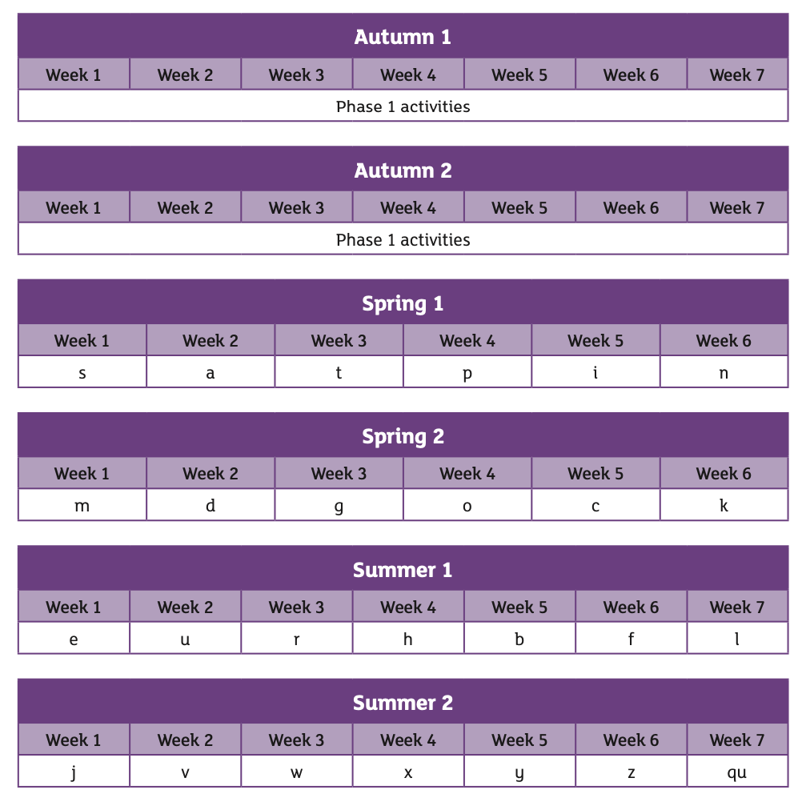
How do we teach phonics?
Notes:
So far the children have been exploring envirmental sounds, instrumentl sounds, body percussion sounds, rhythm and rhyme
Laura

Slide 9
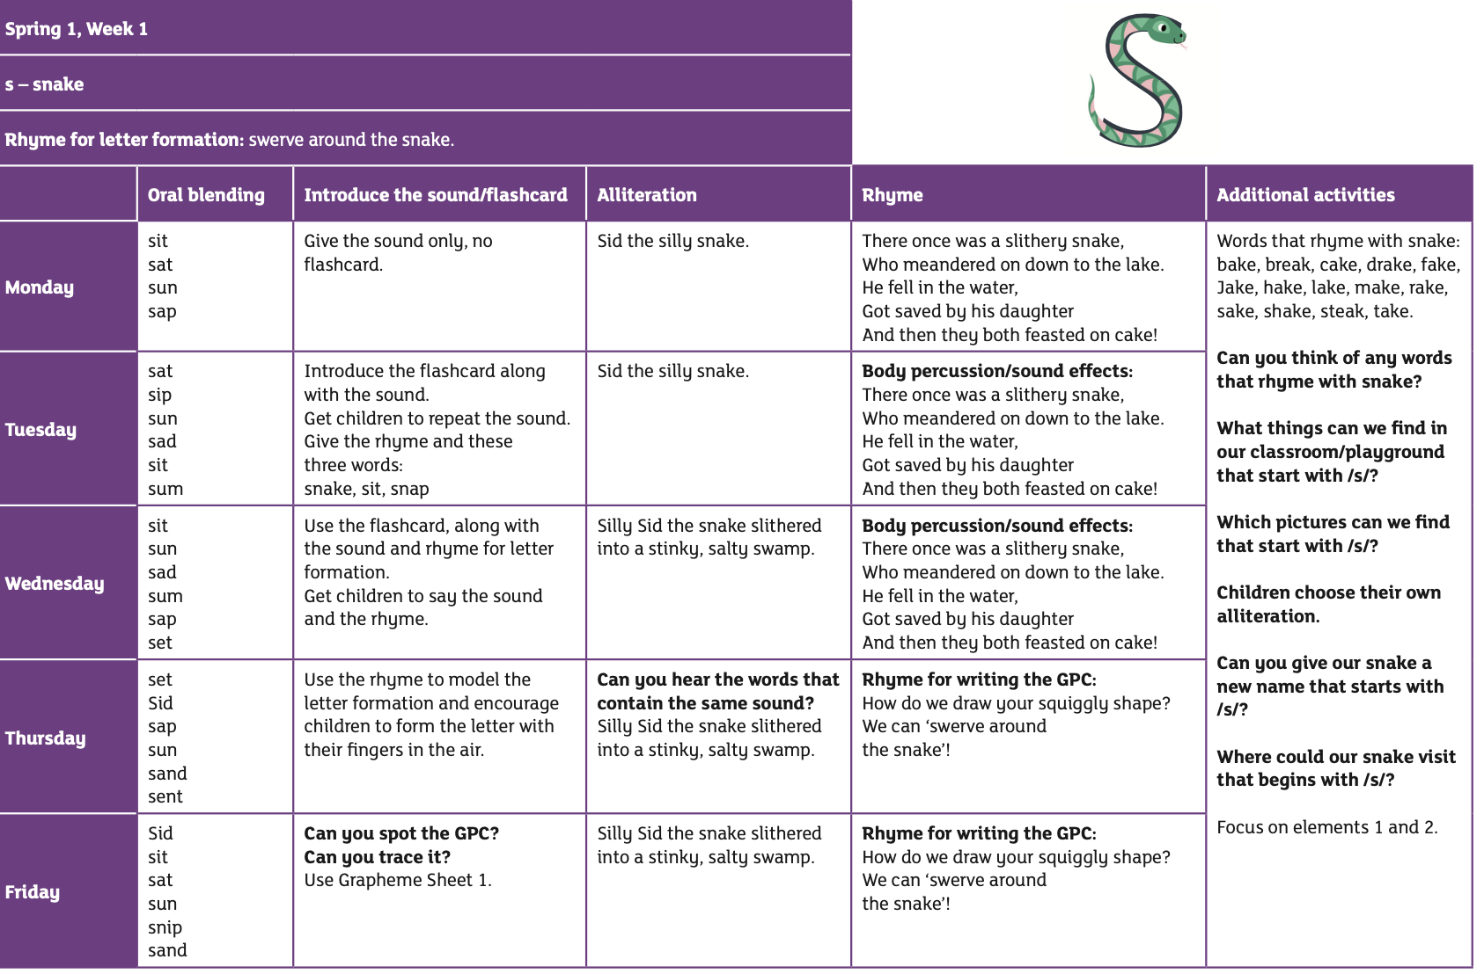
Notes:
An example of what they will be doing in Spring.
Laura

Slide 10
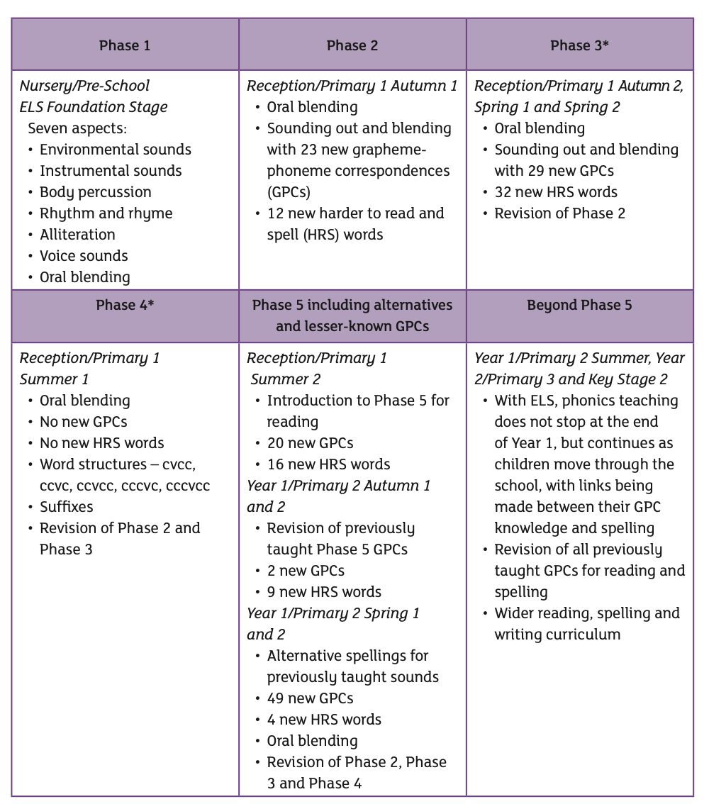
Progression throughout the Early Years into Year 1…
Notes:
Laura talks about nursery
Lucy can do the rest

Slide 11
The importance of pronouncing pure sounds.
We must use pure sounds when we are pronouncing the sounds and supporting children in reading words.
c a t Not. cuh a tuh
If we mispronounce these sounds we will make reader harder for our children.
https://www.youtube.com/watch?v=nBFnAcXHOUQ
Notes:
Lucy

Slide 12
Supporting your child with reading at home
Read your child a bedtime story.
Talk about stories.
Make reading playful. Sing nursery rhymes and songs
Build a print-rich environment.
Try and spot the sounds of the week in contexts outside of school.
Notes:
What they can do so far at this level.
Laura

Slide 13
Supporting your child with reading at home
Only 1 in 3 children are read a bedtime story at home.
Reading a bedtime story improves your child’s outcomes.
If your child views themselves as a ‘good reader’ when they leave Primary School they are more likely to earn a higher salary in their 40s.
At nursery age, reading is about listening, talking, and enjoying books together, not learning to read words independently yet. A warm, shared experience builds the foundation for future reading success.
Notes:
Reading until 3 improves outcomes in reception, reading until 5 improves their outcomes in year 6 and reading until 8 improves outcomes aged 16!
Children who achieve early learning goal for literacy are 11 times more likely to achieve the expected outcomes in maths at the end of KS2, reading underpins everything!
We all want our children able to leave primary school able to read well and you can support us n this journey.
Lucy

Slide 14

Parent drop-ins

